Slide 1

Programming Assignment (#4)
2019. 05. 02.

Slide 2

Before reading this file, we recommend you to read
TA session materials uploaded on the Blackboard.

Slide 3

Summary
Problems
P1. Student ID Classifier
P2. Network Packet Classifier
P3. Social security numbers Classifier
Input file formats
Output formats
Submission

Slide 4
P1. Student ID Classifier
Description:
Identify whether the given string is a Student ID whose
major in Computer science and Engineering or not.
Given String Format : XXXXXXXXXX(String length 10)
Consider that the major code must is 320
(Major code: 320 = Computer science and Engineering)
Admission year
Major Code
Input | Output
2011320003 | Y
2017322001 | N
2008870121 | N
2018320088 | Y
2011000000 | N
2013333111 | N
2015320168 | Y

Slide 5
P2. Network Packet Classifier
Description:
1. Identify whether the given network packet is a ARP Broacast packet or not. If the given network packet is a ARP Broadcast packet, print the source mac address through stdout
2. Identify whether the given network packet is a IPv4 packet or not. If the given network packet’s type is Ipv4, print the destination mac address through stdout
First 14bytes of any packets are “Ethernet” section.
At Ethernet, first 6bytes are destination mac address and next 6bytes are source mac address. And last 2bytes mean the type of packet.
Destination MAC
Source MAC
Type

Slide 6

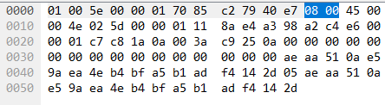
P2. Network Packet Classifier
Example:
1. ARP Broadcast
If first 6bytes are "ff ff ff ff ff ff” and last 2bytes are “08 06”, It is the ARP Broadcast packet.
2. Ipv4
If last 2bytes are "08 00”, It is the Ipv4 packet.

Slide 7
P2. Network Packet Classifier
Input | 4 d05099a54f5064ae0c4132c0080045000028b4274000f106a9ed36c0af2aa398a23701bbe6062b9cd09bff5b31495011007f6efb ffffffffffff00089f79bde00806000108000604000100089f79bde0a398a230000000000000a398a258 af2aa398a23764ae0c4132c0080645000028b4274000f106a9ed36c0af2aa398a23701bbe6062b9cd09bff5b31495011007f6efb 79bde0a398a200089f79bde00842000108000604000100089f79bde0a398a230000000000000a398a258
Output | d05099a54f50 00089f79bde0 N N

Slide 8
P3. Social security numbers Classifier
Format
YYMMDD-GAAAANC
YY: Year of birth (last 2 digits)
MM: Month of birth (in Arabic numeral system)
DD: Day of birth
G: Gender (1,3 for men, 2,4 for women)
AAAA: Area code (can be any 4-digit number in this assignment)
N: Number of acceptance. (can be any single-digit number)
C: Checksum.
Example
890630-1072156 → A man born on June 30, 1989.
011212-4043135 → A woman born on December 12, 2001.
Checksum calculation
(16 + 27 + 0 + 30 + 18 + 0 + 8 + 0 + 14 + 6 + 4 + 25) mod 11 = 5 (remainder)
11 (fixed) – 5 (remainder) = 6 (checksum)
If checksum >= 10, then use checksum % 10
 | 8 | 9 | 0 | 6 | 3 | 0 | - | 1 | 0 | 7 | 2 | 1 | 5 | C
X | 2 | 3 | 4 | 5 | 6 | 7 |  | 8 | 9 | 2 | 3 | 4 | 5
 | 16 | 27 | 0 | 30 | 18 | 0 |  | 8 | 0 | 14 | 6 | 4 | 25
← SSN
← Key

Slide 9
P3. Social security numbers Classifier
Conditions need to check
Classification according to year of birth
Differences in the gender number
1920 ~ 1999 → 20xxxx – 1xxxxxx , 99xxxx – 2xxxxxx, … (starts with 1, 2)
2000 ~ 2019 → 00xxxx – 3xxxxxx, 19xxxx – 4xxxxxx, … (starts with 3, 4)
Validation of the checksum value
Invalid checksum value would not be accepted
String format
In this assignment, there is only single format of the SSN would be accepted
(6-digits) + (single space) + ‘-’ + (single space) + (7-digits)
xxxxxx-xxxxxxx (No)
xxxxxx –xxxxxxx (No)
xxxxxx- xxxxxxx (No)
xxxxxx xxxxxxx (No)
xxxxxxxxxxxxx (No)
xxxxxx – xxxxxxx (Yes)

Slide 10
P3. Social security numbers Classifier
Conditions need to check
Validations of the date
Month → 1 ~ 12
Day → 1 ~ 31
Jan, Mar, May, Jul, Aug, Oct, Dec (ends with 31)
Apr, Jun, Sep, Nov (ends with 30)
Feb → ends with 28 or 29 (consider the ‘leap year!!!’)
Leap year
If (leap year) then
February ends with 29
else // (common year)
February ends with 28
Algorithm
if (year is divisible by 4) then (it is a leap year)(MODIFIED)

Slide 11
P3. Social security numbers Classifier
For example
Input | Output
920229 - 1239536 | Y
880228 - 1234568 | Y
971130 - 3325808 | N
910125-1289204 | N
170101 – 3365983 | N
111231 – 3111220 | Y
180101 – 3365986 | Y

Slide 12
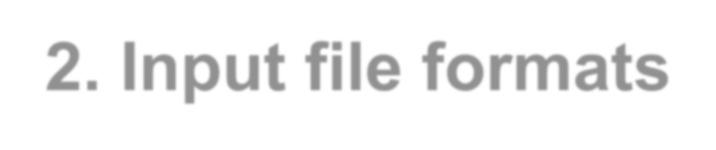

2. Input file formats
We prepared input file for grading your program.
Your program should support arguments for the input file path. See sample codes in TA session materials.
Input file will follow below formats.
Input
³ Number of test case (P1) 2011320003 2017322001 2008870121 Number of test case (P2) Number of test case (P3) 1 ffffffffffff00089f79bde00806000108000604000100089f79bde0a398a230000000000000a398a258 3 170101 - 1365983 111231 - 3111220 180101 - 3365986

Slide 13
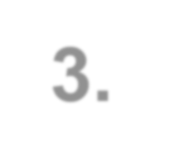



3. Output formats
We will grade your program automatically based on the outputs.
Your program should print “Y” or “N” or hex value through stdout.
Output
Y
N
N
00089f79bde0
N
Y
Y

Slide 14
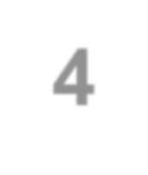
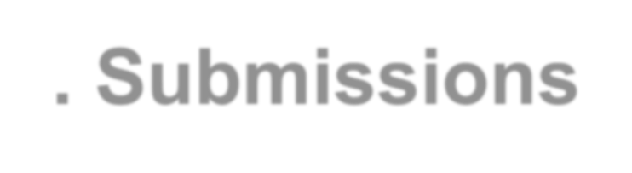

4. Submissions
You have to submit following materials
Source code and an executable file of the program that checks the validity of input string by using one of the below library
Python re (recommended)
PCRE (recommended)
Regex
Google RE2
A report file. It should describe the environment, algorithm, explanation of your code, regex and the result specifically.
Please submit on the blackboard until Wednesday, May 15th, 2019, 11:59 PM(KST).
Late submission is penalized 10% for one day, 20% for one week. No
further submission will be accepted.
All the compile and execution error will be penalized.

Slide 15


Q & A
Please mail us if you have any questions!
TA: geldkang@korea.ac.kr
sunghan-park@korea.ac.kr bible_kwon@korea.ac.kr
Office: Woojung CIC Building Room #307B

